Slide 1
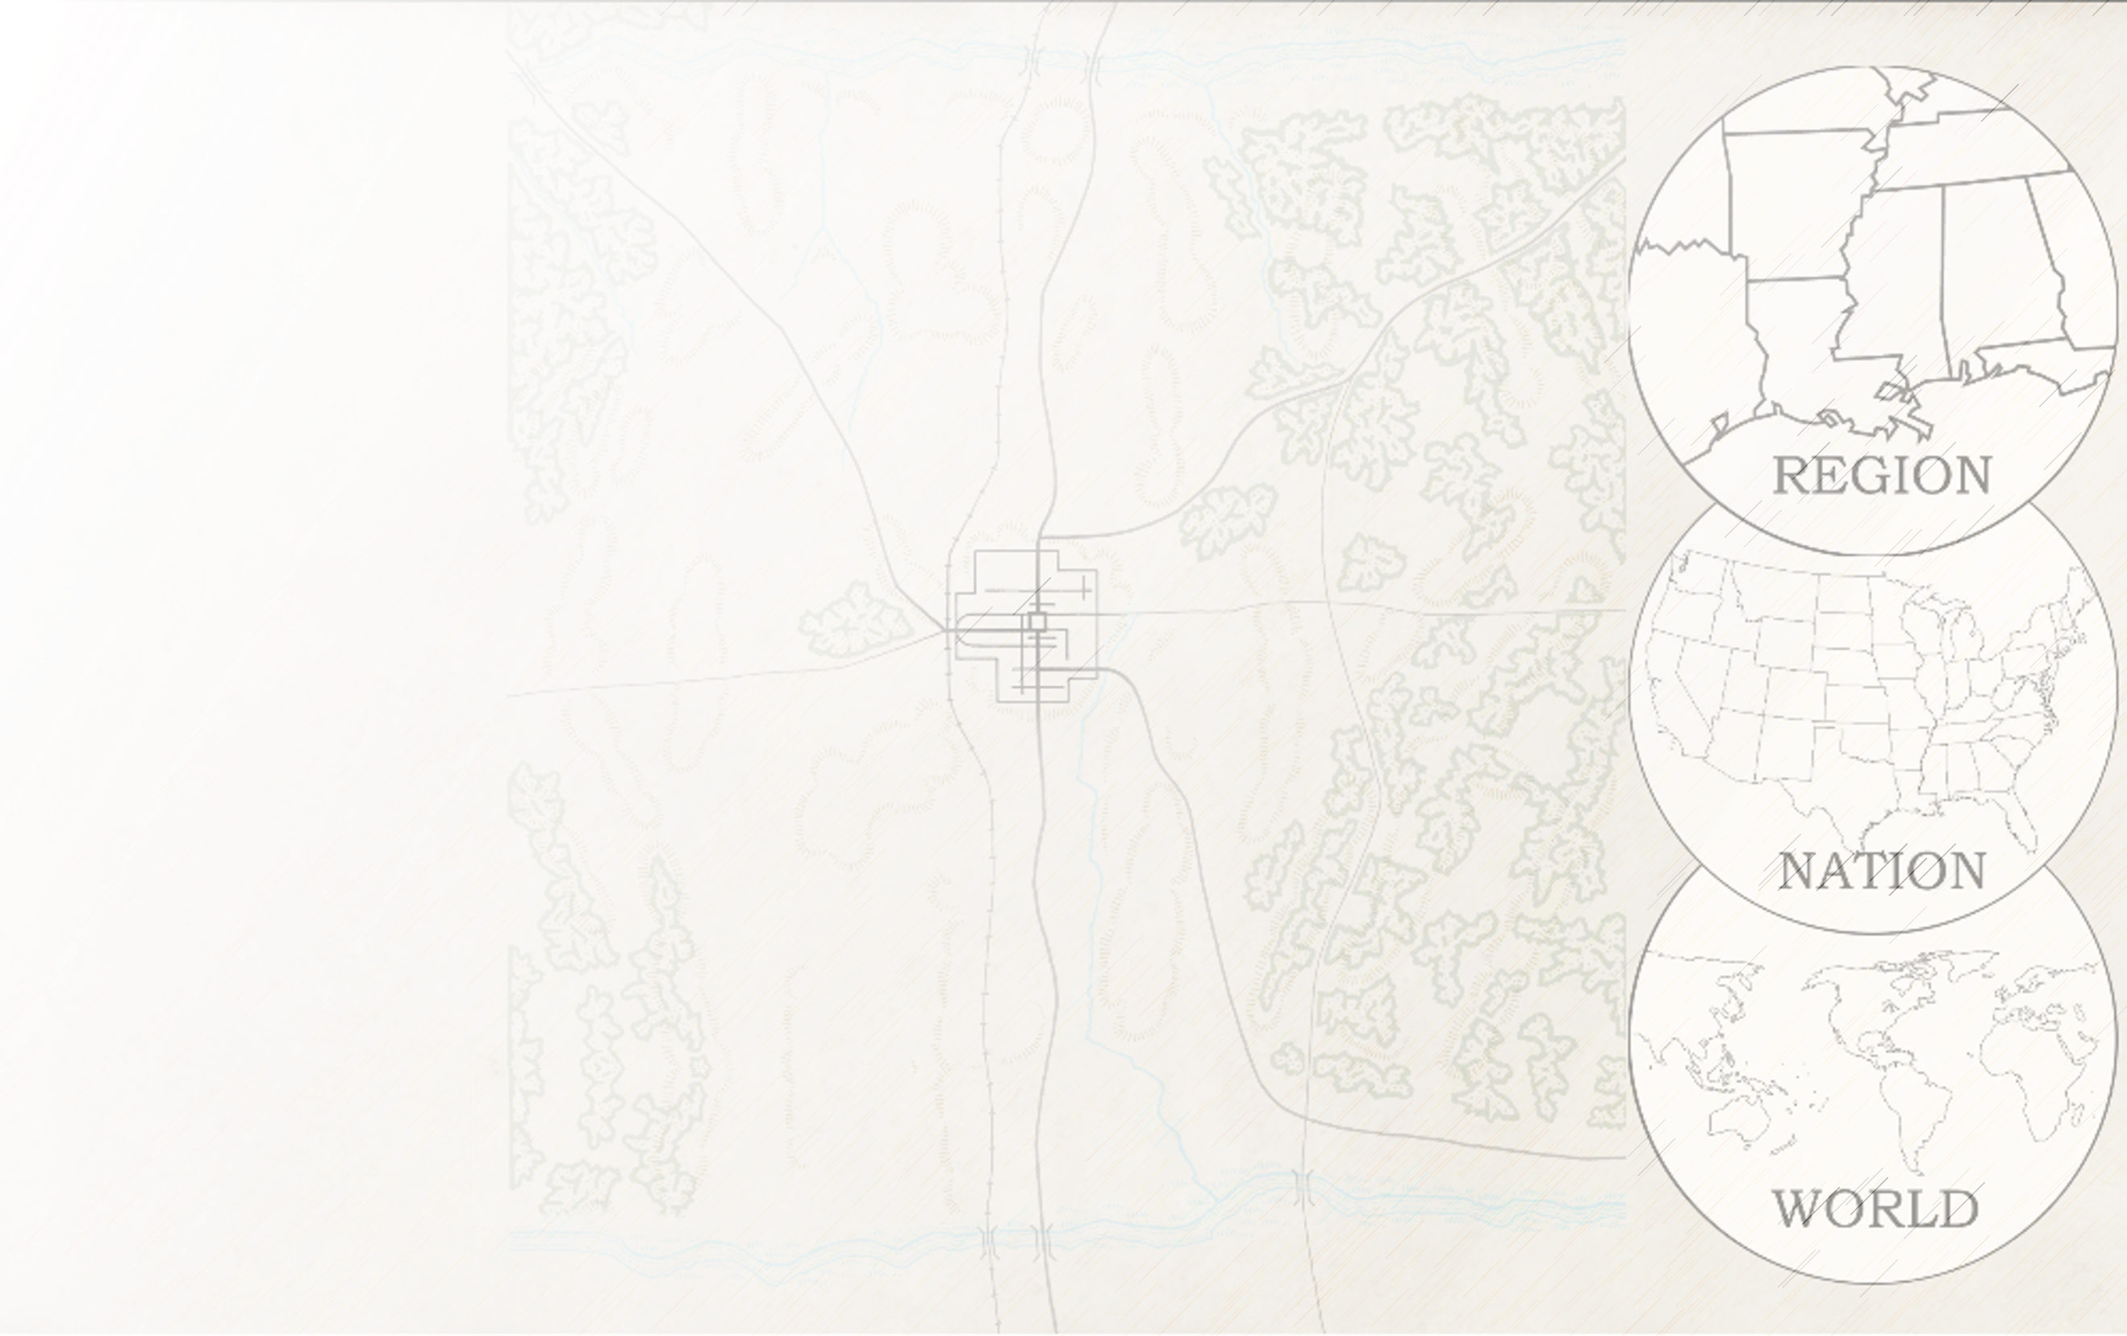


The Bitter Sum: Accounting for Racist Words in Absalom, Absalom!
Johannes Burgers
Assistant Professor of Digital Humanities and English
Ashoka University, New Delhi
Associate Director, Digital Yoknapatawpha
The University of Virginia

Slide 2
Overview:
A). Methodology
B). Statistical Overview
C). Sentiment Analysis
D). Character, Time, and Location Frequency analysis; or three ways of saying Thomas Sutpen

Slide 3
Thesis
A statistical overview of Absalom, Absalom! suggests that the use of the n-word is the most ubiquitous around Thomas Sutpen. In particular, it the events where the n-word is used the most are those surrounding his origin story in Tidewater, VA in the 1830s.

Slide 4
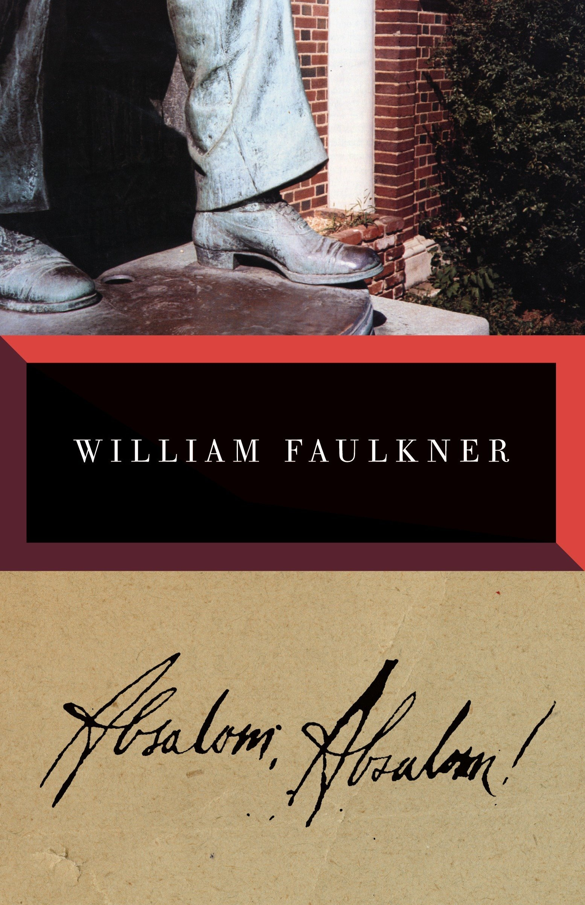
Methodology
Corpus Linguistics
Statistical analysis of word use in a text

Slide 5
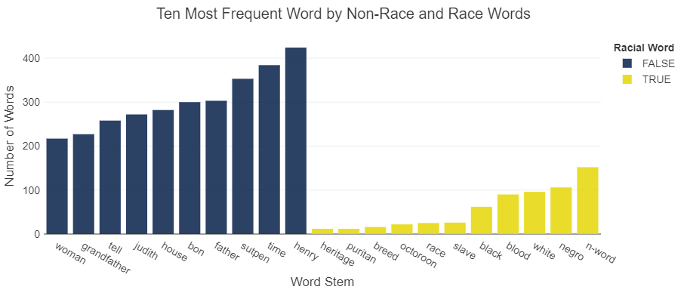
Word Frequency

Slide 6
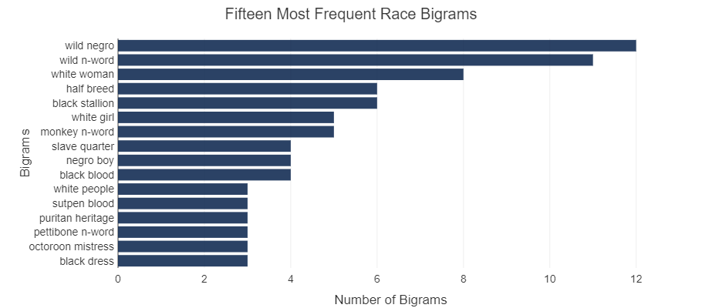
Bigram Frequency

Slide 7
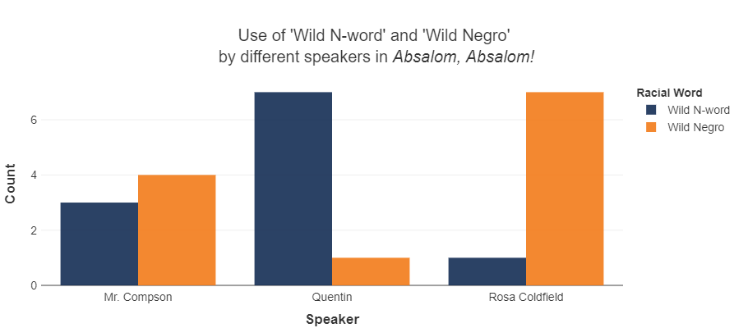
Use of ‘Wild Negro’ vs. ‘Wild n-word’

Slide 8
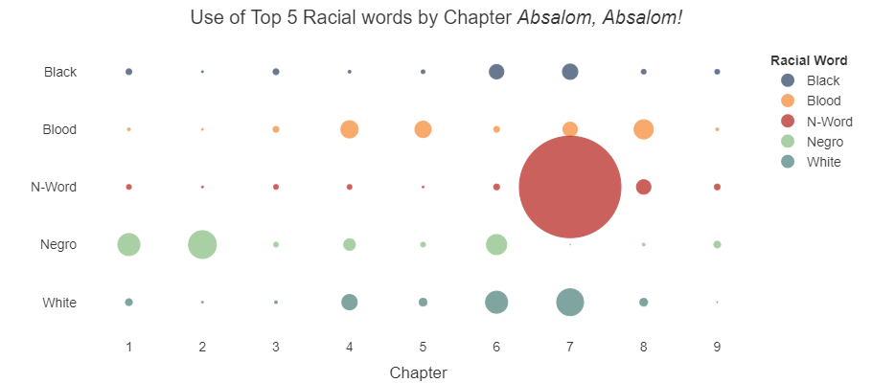
Race Word Across Text

Slide 9
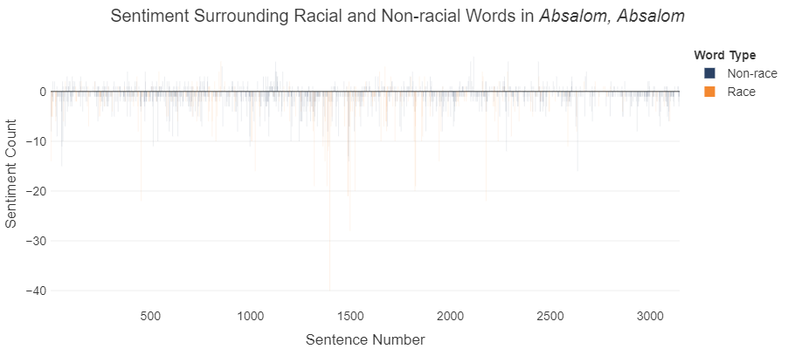
Sentiment of Race Word

Slide 10
Advanced Methodology
Computers
Merge Digital Yoknapatawpha Database
DIGITAL
Yoknapatawpha
Source code: Absalom and Racial Words: Text Processing Supplement

Slide 11
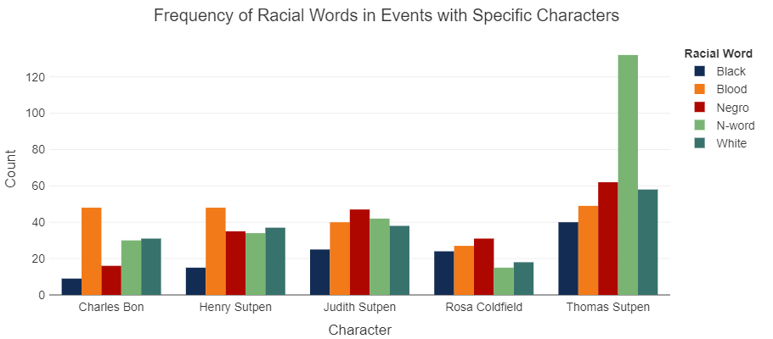
Frequency by Character

Slide 12
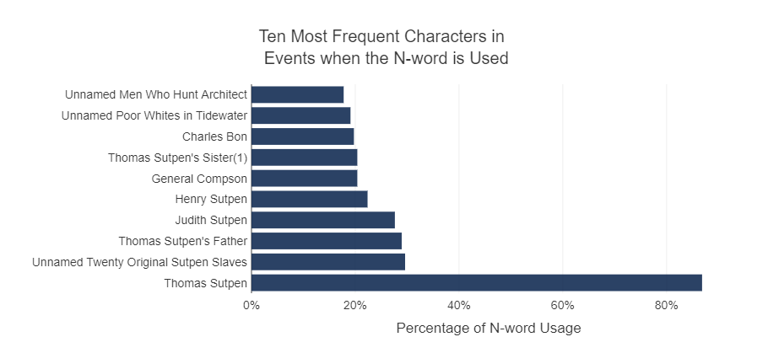
Present when N-word is used

Slide 13
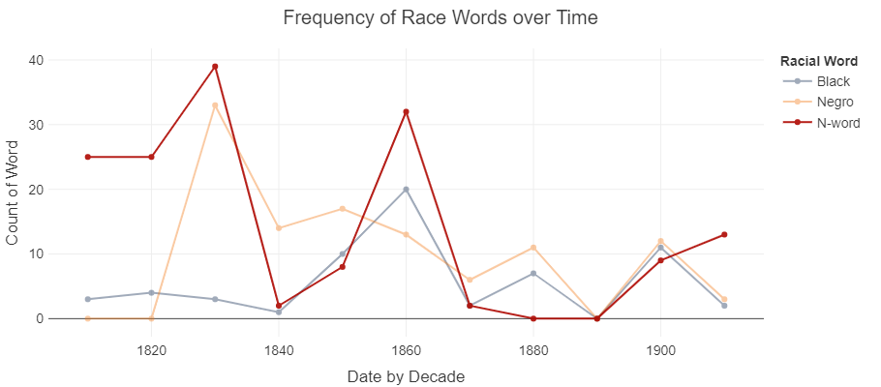
Time Period When the N-Word is used

Slide 14
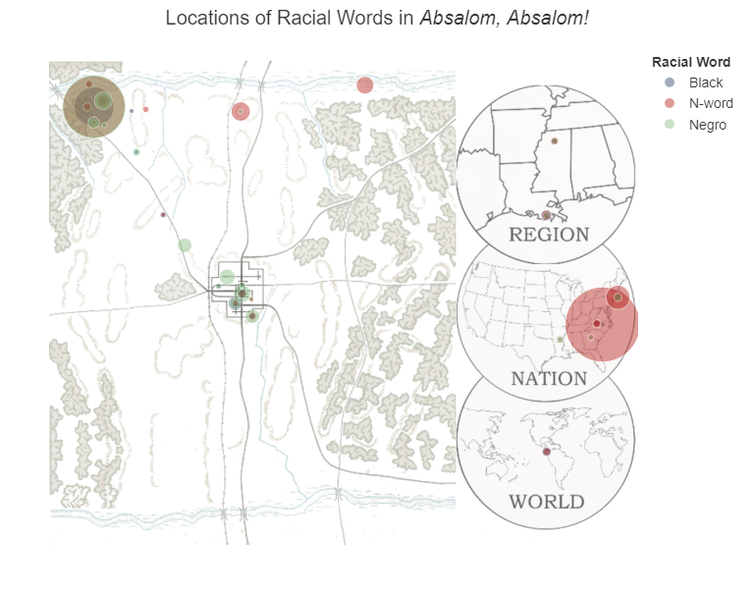
Place where it is used

